Slide 1
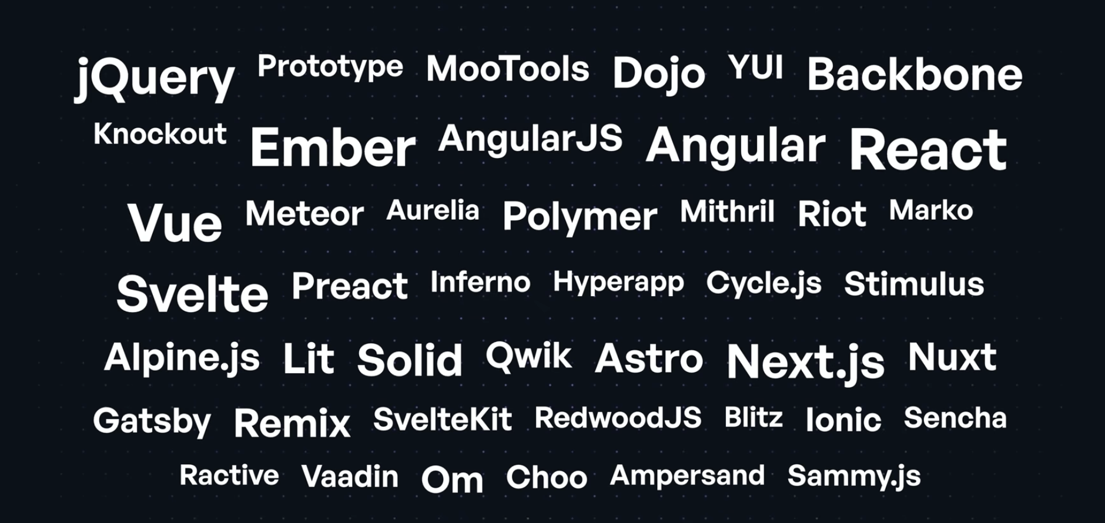
NodeJS / JavaScript: Bundler, Framework
Same thing is happening to Agentic development / Agent Harness

Slide 2
How I started, what I was seeing
Industry was heading towards
The Paradigm Shift | The Era Before
Webpack (Bundlers) | Developers manually ordered <script> tags, managed global namespaces, and used task runners (Grunt/Gulp) for basic concatenation.
Node.js (Server-Side JS) | JavaScript was locked in the browser. Backend logic and local build tooling required completely different languages like PHP, Ruby, or Java.
React (Declarative UI) | Developers manually manipulated the DOM using jQuery and wrote bespoke, cross-browser-specific UI code rather than using reusable components.
TypeScript (Strict Typing) | Developers relied on CoffeeScript for syntactic sugar or wrote loosely typed Vanilla JS, catching critical logic errors only at runtime.
REST/gRPC (APIs) | Services communicated via rigid, heavy protocols like SOAP and XML-RPC. (Note: HATEOAS is actually a core design constraint of REST itself, not a predecessor).
State Management | Application state was stored directly inside the DOM (using data- attributes) or scattered across fragile global variables.
Chat
Stream
Server-Sent Events (SSE)
Schema
Registry
Budget
Session
Observability
Lifecycle (hooks)
Prompt
Feedback Loops(HITL)
Retry
Reporting
Token Maxing: Relying heavily on short-term conversational state by simply appending messages leads directly to context window exhaustion and massive latency spikes.
Memory Failures: Failing to properly integrate RAG vector stores or structured state objects causes agents to suffer from the "lost in the middle" recall problem during long-running tasks.
Token Maxing: Relying heavily on short-term conversational state by simply appending messages leads directly to context window exhaustion and massive latency spikes.
Memory Failures: Failing to properly integrate RAG vector stores or structured state objects causes agents to suffer from the "lost in the middle" recall problem during long-running tasks.
Agentic Harness Overhead: Building a production-grade agent requires a massive web of complex infrastructure—handling everything from Language Server Protocols to secure microVM sandboxes for code execution.
100x Code Sprawl: The sheer volume of AI-generated code forces teams to rely heavily on automated CI gateways and deterministic rule-checking engines to prevent security vulnerabilities and tech debt from flooding production.
Single Point of Failure: Over-leaning on a single "next-gen" model creates severe vulnerabilities; an unannounced API upgrade can break deterministic tool-calling behavior entirely.
Ignoring the Data Flywheel: Teams often treat the LLM as a magic bullet rather than implementing continuous evaluation traces to measure tool-call success rates, latency, and cost per task.

Slide 3
SDK Harness Features
Example | Type | Description (what it does)
Chat | Chat | Sends a single prompt and prints the reply, showing how to configure the model id and reasoning effort.
Stream Chat | Streaming | Streams the response as message deltas using an async iterator instead of waiting for the full reply.
SSE Server | Server-Sent Events (SSE) | Runs an HTTP server that relays streamed deltas to clients as Server-Sent Events, plus a /usage endpoint.
Structured Output | Schema | Sends structured input and validates the model's JSON output against a JSON Schema, auto-repairing invalid responses.
Tool Calling | Registry | Registers custom tools (weather + add) that the model can invoke, running your code mid-conversation.
Token Budget | Budget | Analyzes token cost before a run, blocks requests that exceed a budget, and reports usage after.
Session Persistence | Session | Persists conversation context to disk and resumes/replays it later with --continue.
Trace | Observability | Emits OpenTelemetry golden signals and writes a CLI-side trace file for inspection.
Hooks-and-events | Lifecycle | Walks the full hook pipeline, adding a policy hook that vetoes actions.
System-prompt | Prompt | Loads instructions from file and shows append vs replace modes.
Example | Type | Description (what it does)
Multi-turn-chat | Chat + Prompt | Carries a conversation context so follow-ups resolve earlier messages.
Resume-session | Session | Compares resumeSession and continueFrom (resume-or-replay).
RAG grounding | Schema | Feeds retrieved snippets, gets a schema-validated answer with citations.
LLM-as-judge | Schema | Grades a candidate answer using structured() output with repair.
Classification | Schema | Batch-classifies items in a structured loop and rolls up total usage.
Human-in-the-loop | Feedback Loops | Prompts the user via CLI to allow or deny each tool call.
PII redaction hooks | Lifecycle | Redacts PII before sending, with a guardrail that verifies the redaction worked.
Resilience retry | Retry | Wraps chat() with exponential backoff and falls back to an alternate model on failure.
Cost-report | Reporting | Produces per-model costs plus latency via usageSummary() / usageReport().
REPL | Chat | Runs an interactive test/dev environment session.

Slide 4





Don’t confused AI harness with Test Harness
Cloudflare is invested in Agent harness
Y Combinator
Build your own vulnerability harness
Github Opensource security-audit-skill
Agent Platform SDK
Test Harness
Agent Harness
Agent API (Message API / Agent SDK runtime)
Pi Agent Harness - AI agent toolkit: unified LLM API, agent loop, TUI, coding agent CLI
A multiplayer agent harness for work. In Slack and on the web. QM
Most agents are designed like personal assistants. You can make one work for a whole company, but it quickly gets complex. QM is designed for startups. Employees each get their own isolated workspace and work independently without affecting each other, and they can also collaborate with the agent in channels, group messages, and projects.
Each person and each room has its own scoped memory, files, keychain view, permissions, crons, web apps, and durable sandbox.
How harnesses fit
Harnesses sit on top of the Agents SDK runtime:
The runtime gives the agent durable infrastructure: the Agent class, state, sessions, routing, WebSockets, scheduling, fibers, and observability.
The harness gives the agent behavior: model calls, prompt construction, tool selection, stream handling, memory strategy, and lifecycle hooks.
The runtime answers “where does this agent live and how does it stay durable?” The harness answers “what does this agent do on each turn?”
Satya Nadella - Microsoft
Create your own continuous learning loop (i.e hill climbing machine) that will allow your AI investments to compound the value of your firm
Beyond conversational AI: Why forward-deployed engineers need a harness for real execution
Sequoia Capital
When to Build Your Own Agent Harness - Harrison Chase - co-founder / CEO of LangChain
Notes:
https://www.youtube.com/watch?v=95XrWA6-UFM
https://www.youtube.com/watch?v=6_BcCthVvb8
https://www.youtube.com/watch?v=8HIoZV7qlwA
https://www.youtube.com/watch?v=HI2q3ci3Iuc

Slide 5
Agentic Engineering: This focuses on building the underlying reasoning loops, memory state folders, and core execution logic that allow large language models to operate autonomously. It involves designing dynamic routing architectures and implementing strict security boundaries for unguided tasks.
Evaluation (Eval) Engineering: This involves assessing the trajectory of an AI system beyond static accuracy scores. Engineers in this space implement continuous evaluation traces to measure tool-call success rates, loop counts, latency per step, and cost per task.
Systems Engineering: This discipline details hardware dependencies, system integrations, security protocols, and data flow. In AI contexts, systems engineers manage runtime isolation layers, such as microVMs and container sandboxes, to ensure agents can safely execute code without risking the host machine.
Harness Engineering
Prompt Engineering
Context Engineering
Data & Knowledge Engineering: This practice involves preparing and structuring factual data for Retrieval-Augmented Generation (RAG) vector stores. It requires choosing between semantic and structure-aware chunking to ensure an agent can accurately parse documentation and preserve logical boundaries.
SDLC
AI-Native SDLC
Agentic Development Life Cycles (ADLC)

Slide 6
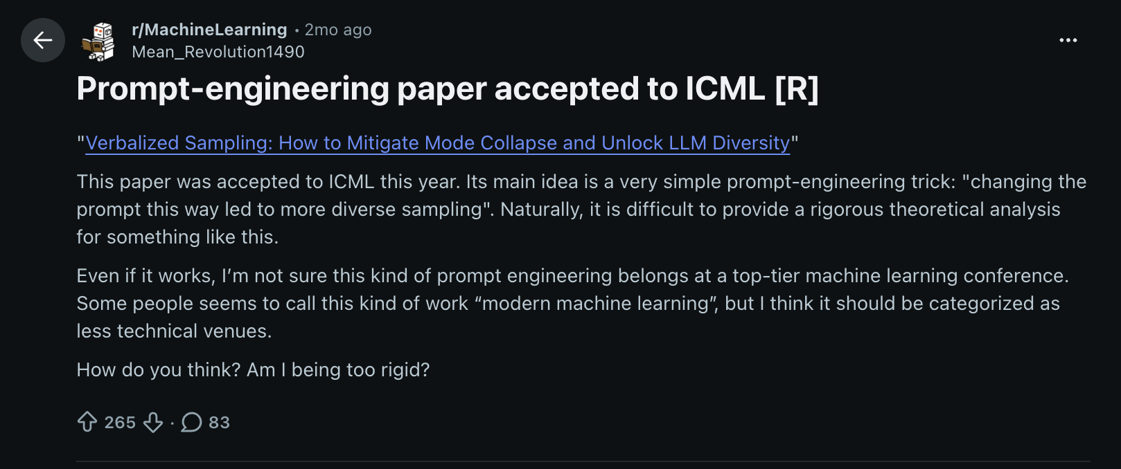
So many opinions, but only facts should matter
“Just a wrapper”
”Just Scaffording”
“Just Prompt + Context”

Slide 7
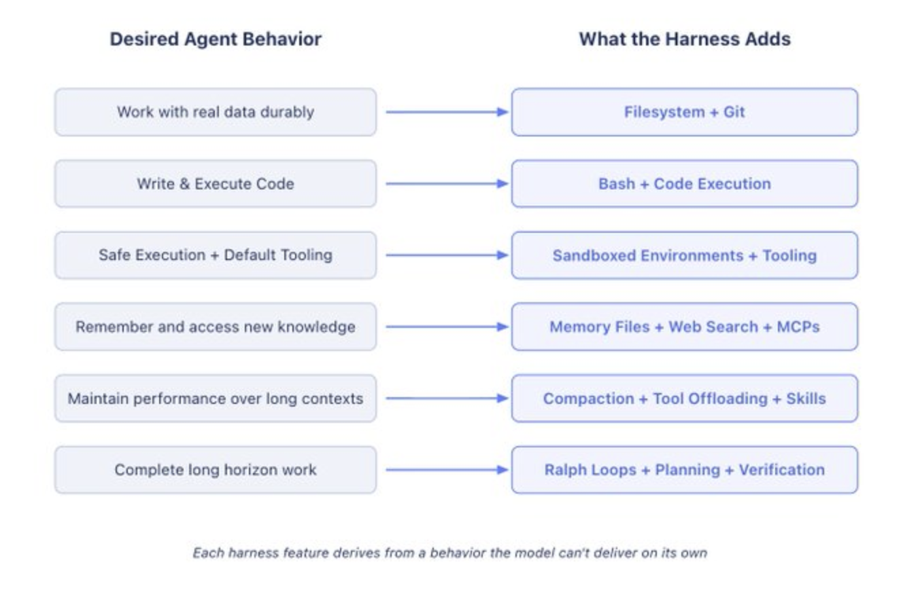
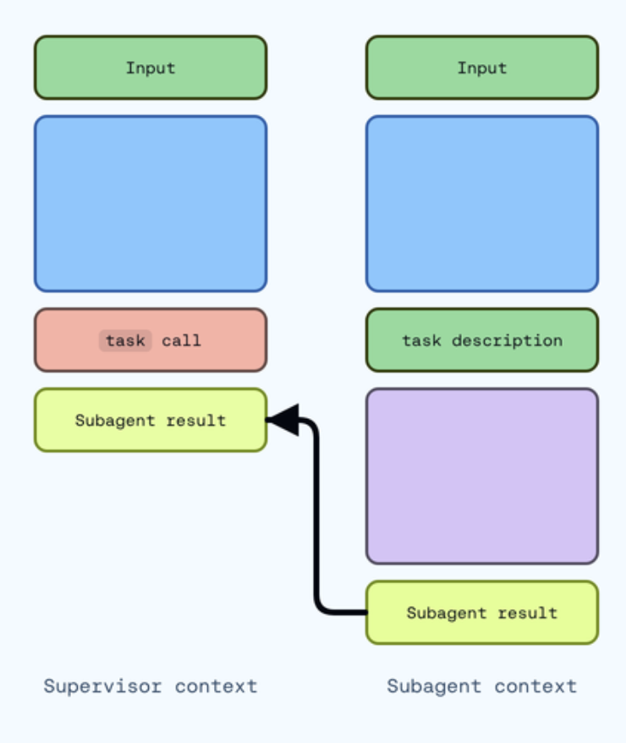
Work Backwards from Desired Agent Behavior to Harness Engineering
Behavior we want (or want to fix) → Harness Design to help the model achieve this.

Slide 8
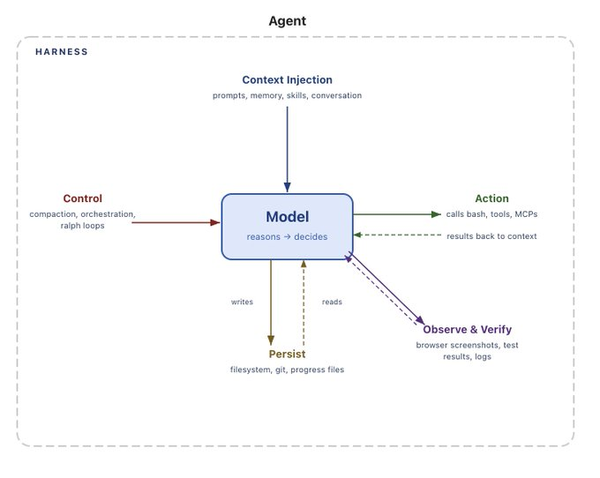
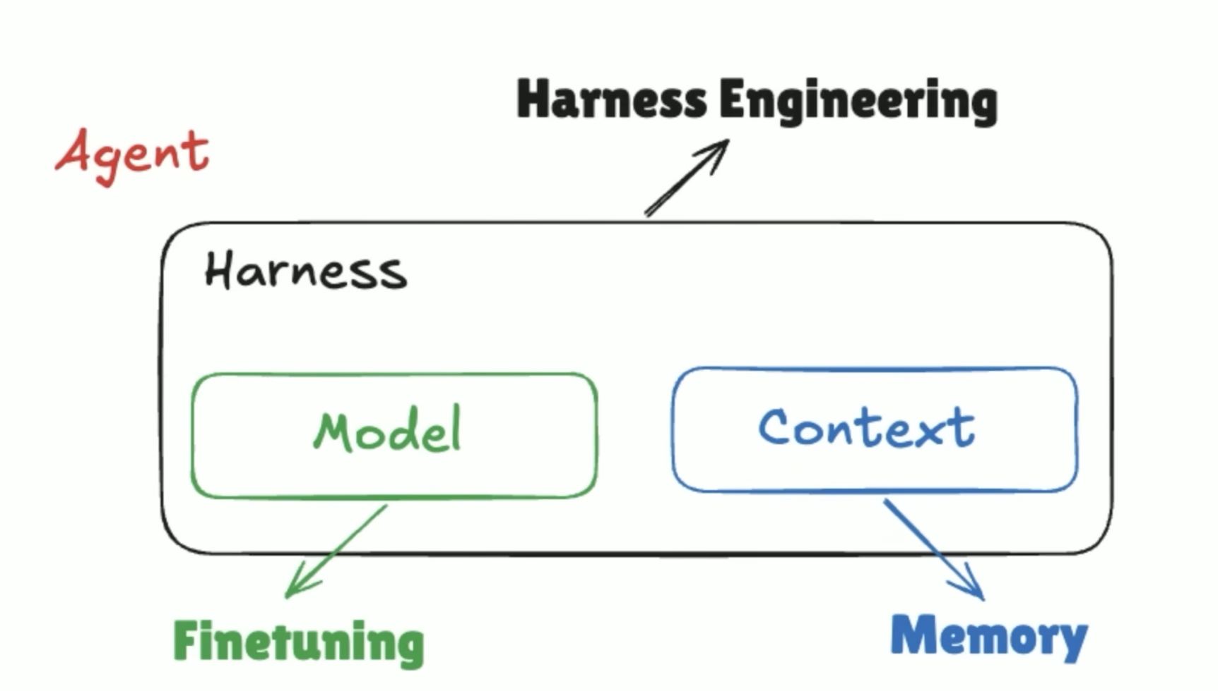
Simple harness
LangChain
Off the shelf Harness
- Github Copilot, Codex, Claude Code, Cursor
> fine tuning harness
> Create custom harness
In distribution in verse out of distribution – customize out of distribution add to harness and keeping in distribution close to the model (model harness)
Deep Agents vs LangChain vs LangGraph
Notes:
https://www.langchain.com/blog/how-to-build-a-custom-agent-harness
https://www.langchain.com/blog/choosing-the-right-multi-agent-architecture
https://www.langchain.com/blog/the-anatomy-of-an-agent-harness
https://www.langchain.com/blog/organizing-context-in-a-multi-agent-harness

Slide 9
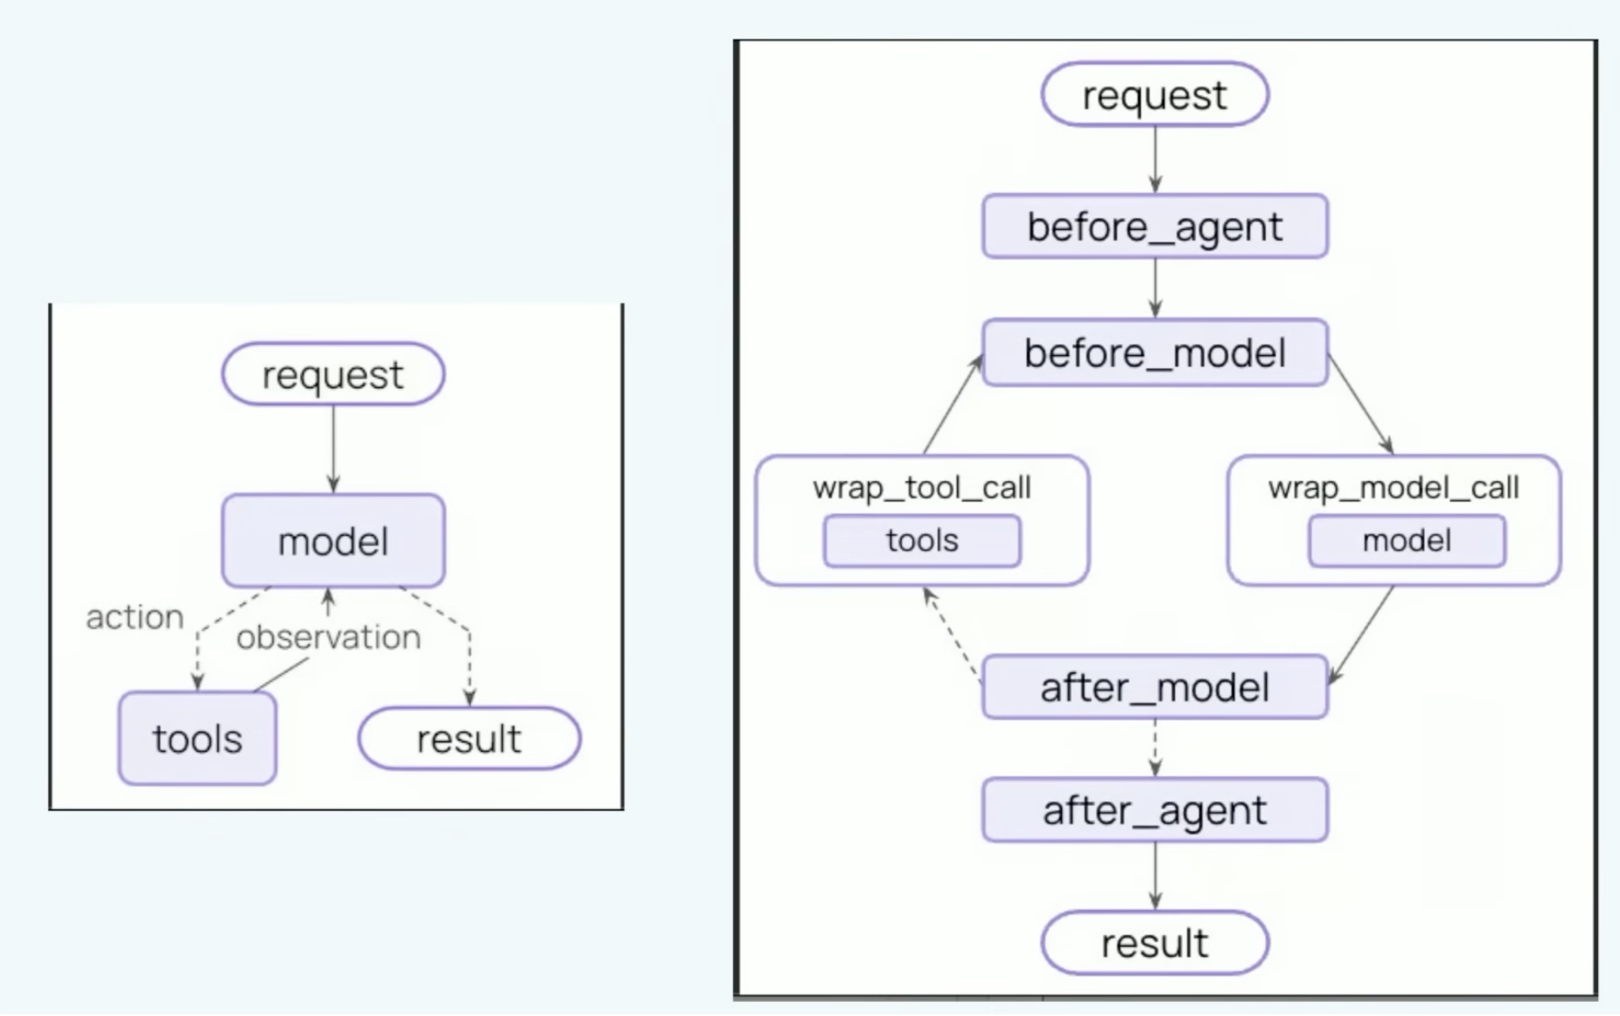
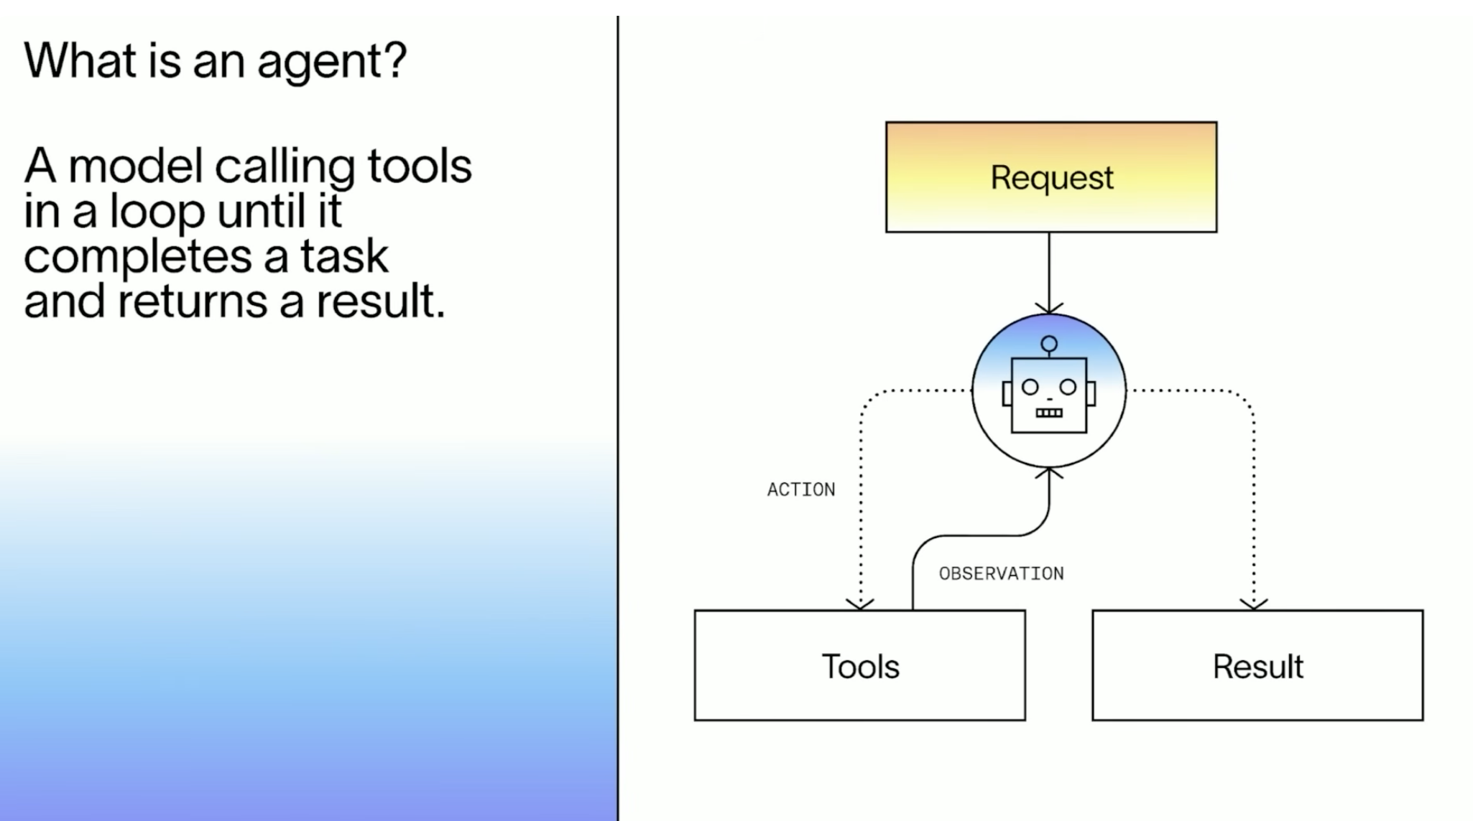
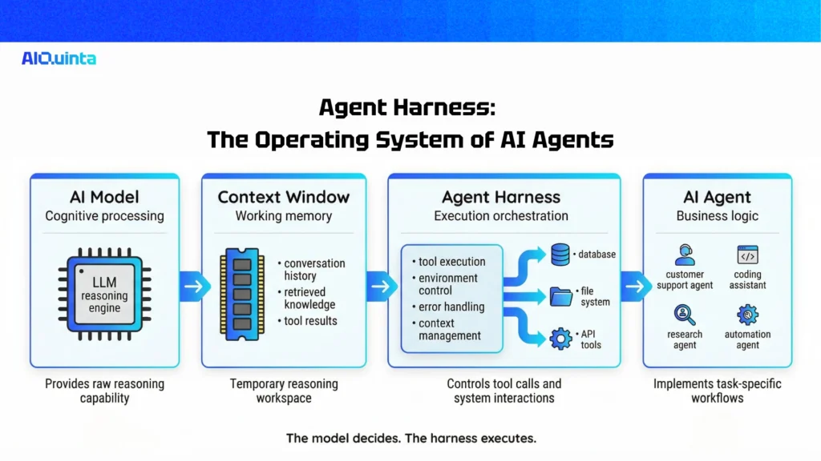
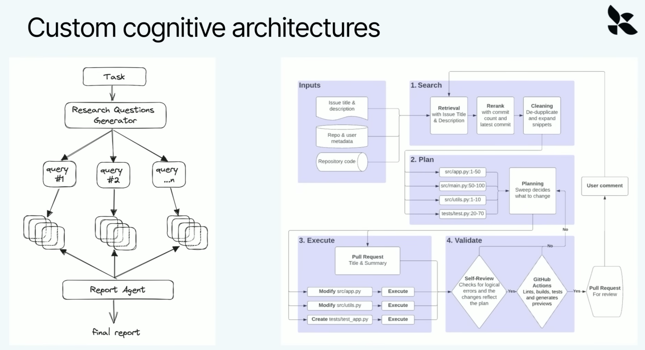
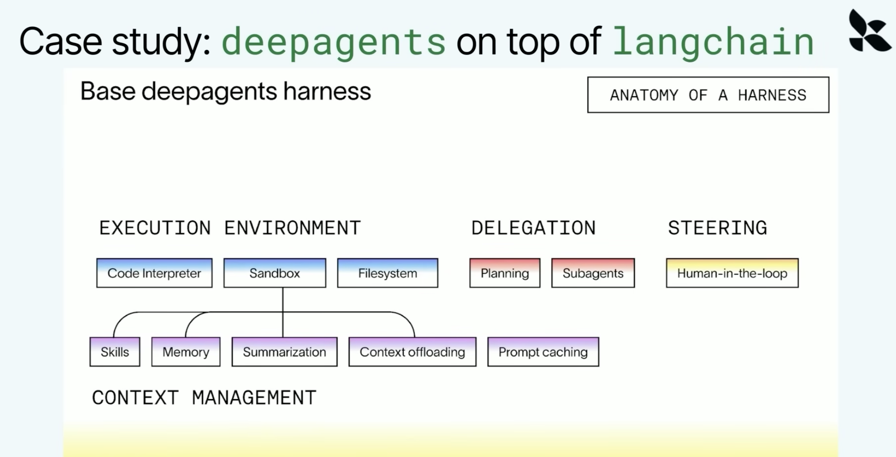
Langchain: simple harness
Langchain Deep Agent: Agentic Framework
Middleware constructs / Plugins / hooks
Customizable Agents
Agent Profile
Source
Go into harnesses

Slide 10
ARC-AGI (The AI Benchmark)
Abstraction and Reasoning Corpus for Artificial General Intelligence (ARC-AGI)
a prominent benchmark created by AI researcher François Chollet in 2019.
Frontier-bench: This benchmark is designed to evaluate the capabilities of AI models in agentic terminal coding.
Terminal bench 2: is a command-line benchmark suite that evaluates AI agents using 89 curated, multi-step terminal tasks.
Humanity's Last Exam (HLE): Evaluates advanced reasoning and highly specialized domain knowledge, designed to be challenging for AI models while remaining solvable by human experts.
SWE-bench: Measures an AI's software engineering capabilities by testing its ability to resolve real-world GitHub issues and generate functional repository-level code.
MMLU (Measuring Massive Multitask Language Understanding): Tests general knowledge and problem-solving skills across dozens of academic and professional subjects, ranging from elementary math to law and medicine.
Chatbot Arena: An open evaluation platform that ranks models using crowdsourced, blind, side-by-side human preference testing during multi-turn interactions.
GPQA (Google-Proof Q&A): Focuses on extremely difficult, graduate-level reasoning questions across biology, physics, and chemistry that are difficult to answer simply by searching the web.
HellaSwag: Evaluates commonsense reasoning by presenting a scenario and requiring the model to select the most logical completion from a set of adversarial options.
BIG-Bench (Beyond the Imitation Game): A collaborative benchmark consisting of hundreds of diverse tasks designed to quantify and extrapolate the capabilities of language models.
SuperGLUE: Tests general-purpose language understanding systems on tasks like textual entailment, question answering, and coreference resolution.
The Goal: It measures "fluid intelligence"—an AI's ability to reason, solve novel problems, and adapt to completely new situations it wasn't explicitly trained on.
How it Works: Rather than testing an AI on memorized data (like passing a medical exam), it presents visual, grid-based logic puzzles that are easy for humans but historically extremely difficult for AI systems.
Why it Matters: It is widely considered one of the only benchmarks that accurately measures actual progress toward true Artificial General Intelligence. It focuses on how efficiently an AI can learn new skills, rather than relying on brute-force data recall.

Slide 11
Protocol Interoperability: Harnesses utilize the Language Server Protocol (LSP) to gain deep language intelligence, such as real-time AST parsing and diagnostics, and the Model Context Protocol (MCP) to dynamically connect to external APIs, databases, and local tools.
Security & Sandboxing: They rely on runtime isolation layers like MicroVMs and container sandboxes (e.g., Docker Sandboxes). This creates a hard security boundary that allows agents to perform unattended code execution, often called "YOLO mode," without risking the host machine.
Runtime or Workspace or Sandbox isolation layers: Dedicated, isolated, Environments like Docker Sandboxes that mount specific workspaces into dedicated microVMs.
Hard security boundaries: Strict perimeters established to allow processes to execute code safely and unattended without risking the broader host system.
Isolated execution environments: Secure microVMs or containers provisioned to keep operations completely separated from other systems.
Container-in-container capabilities: Sandboxing features that allow isolated environments to spin up their own nested, firewall-restricted containers.
Multi-tenancy Isolates users, organizations, projects, policies, secrets, memory, artifacts, and compute.
Granular, agent-specific security boundaries: A term used to describe the isolated, instance-specific permission policies (such as those in a permissions.yaml file) that dictate exactly what a specific tenant or agent is allowed to access.
Editor & IPC Integrations: To bridge communication between the CLI and the editor UI without hanging the terminal, harnesses tap into Inter-Process Communication (IPC) sockets like VSCODE_IPC_HOOK_CLI or utilize "wait" patterns (e.g., code --wait) to capture user input or authentication credentials natively.
Path-Gated Rules: Instead of loading every instruction globally, harnesses use directory-specific gateways (such as .cursor/rules/*.mdc or .github/instructions/) to trigger specialized contextual prompts only when an agent edits a matching folder.
State & Memory Persistence: Autonomous harnesses heavily prioritize state tracking to prevent context window exhaustion and "lost in the middle" recall issues. They manage this through rolling summaries, chronological transcript logs (history.jsonl), and persistent state files (state.json) that track active directives across sessions.
Routing Architectures: Developers must intentionally design the harness to balance deterministic, script-based workflows with dynamic LLM-driven autonomous routing (like the ReAct or Plan-and-Execute patterns) to prevent agents from hallucinating dead-end paths or getting stuck in infinite loops in production.
Tool Abstraction: Typed wrappers around shell, filesystem, Git, HTTP, browser, databases, cloud APIs, etc. instead of unrestricted raw execution.
Discovery: Lets agents discover available capabilities progressively rather than loading every tool/schema into context.
Permissioning: allow / deny / ask / scoped policies per tool, command, path, user, agent, repository, or environment.
Delegation: Gives subagents temporary, restricted capabilities rather than inheriting the parent agent's full authority.
Interception: Inspects proposed shell/tool operations before execution; blocks dangerous patterns or rewrites them into safer operations.
Resource Governance: Limits tokens, model spend, execution time, disk, memory, processes, API calls, network traffic, and concurrency.
Network Governance: Domain allowlists, egress controls, proxying, DNS restrictions, credential-aware routing, and offline execution.
Filesystem Virtualization: Worktrees, overlays, temporary directories, snapshots, read-only mounts, scoped writable paths, and rollback.
Environment Management: Creates reproducible runtime environments and injects only the dependencies/configuration required for a task.
Secrets Management: Injects credentials just-in-time without putting secrets directly into prompts or agent-visible state.
Identity / RBAC / ABAC: Determines what a user, agent, subagent, skill, or workflow is authorized to perform.
Policy Engine: Evaluates organizational rules independently of the LLM: compliance, security, data handling, deployment, licensing, etc.
Human-in-the-Loop: Pause → inspect → approve/reject/edit → resume, with escalation based on risk rather than every operation.
Checkpointing: Serializes execution state so a task can resume after crashes, restarts, model failures, or human intervention.
Branching / Rewind: Forks from checkpoints, tries alternatives, compares results, or rewinds to a known-good state.
Durable Execution: Turns a 3-hour agent run into a recoverable workflow instead of one giant fragile LLM conversation.
Compensation / Rollback: Defines reverse operations when an agent partially completes a multi-step transaction.
Artifact Management: Treats generated code, plans, reports, patches, screenshots, logs, test results, etc. as first-class versioned artifacts.
Context Engineering: Selects what goes into the model context instead of blindly appending conversation history.
Context Compression: Summarizes, deduplicates, ranks, chunks, expires, and retrieves information according to relevance.
Progressive Disclosure: Exposes capability contracts first and implementation details only when required.
Repository Intelligence: Builds structural maps of repositories: languages, packages, dependencies, ownership, symbols, tests, build systems, etc.
Semantic Retrieval: RAG over code, documentation, tickets, architecture decisions, prior executions, and organizational knowledge.
Model Routing: Routes simple operations to cheap/fast models and difficult reasoning to stronger models.
Agent Routing: Delegates work to specialized agents such as planner, coder, reviewer, tester, security reviewer, researcher, etc.
Skill Routing: Maps intent → skill → tools rather than requiring the model to rediscover procedures every run.
Task Decomposition: Converts an objective into tasks, dependencies, DAGs, milestones, and executable units.
Parallel Execution: Runs independent agents/tasks concurrently while controlling shared state and merge conflicts.
Agent Coordination: Mailboxes, queues, blackboards, event buses, structured messages, ownership, locks, and synchronization.
Conflict Resolution: Handles multiple agents modifying the same files/resources or producing incompatible conclusions.
Verification: Separates generation from validation: tests, schemas, static analysis, policy checks, security scans, visual checks, etc.
Structured Outputs: Enforces JSON Schema, Zod, Pydantic, protobuf, typed events, or other contracts instead of trusting prose.
Self-Correction Loops: generate → validate → diagnose → repair → validate with bounded retry policies.
Quality Gates: Prevents advancement until required tests, linting, security checks, coverage, approvals, or validations succeed.
Stop Conditions: Defines success, failure, retry, escalation, timeout, maximum iterations, and budget exhaustion.
Observability Traces prompts, models, tool calls, tokens, latency, state transitions, artifacts, errors, and decisions.
Replay: Reconstructs an execution from its event history for debugging, auditing, or regression testing.
Provenance: Records where generated information / code came from and which inputs influenced a decision.
Event System: Emits events such as task.started, tool.called, approval.required, artifact.created, task.completed
Hooks / Middleware: Provides interception points before/after prompts, model calls, tool execution, writes, commits, deployments, etc.
Session ManagementMaintains multiple independent task/session/workspace contexts and lets them resume later.
SchedulingRuns agents periodically, at a specific time, from queues, or in response to external events.
Triggers / WebhooksStarts workflows from GitHub, Jira, Slack, CI, monitoring alerts, email, APIs, filesystem changes, etc.
Background ExecutionAllows long-running tasks to continue independently of an interactive CLI/editor session.
NotificationsReports completion, failure, approval requests, budget thresholds, or anomalies through external channels.
Extension SystemAllows new agents, skills, commands, MCP servers, plugins, hooks, models, policies, and tools to be installed.
Evaluation: Runs agent behavior against golden tasks, regression suites, benchmarks, and production traces.
AuditabilityMaintains immutable records of who/what/when/why for actions taken by autonomous systems.

Slide 12
Harness
CLI
SDK
Server
Idempotency: An idempotent script yields the exact same result whether executed once or a thousand times
Detection (State Check): Before modifying anything, the system must query the environment to assess if the required tool or its dependencies already exist.
Resolution (Version Matching): The system must parse the currently installed version and compare it against required constraints. If the version matches, the setup skips directly to verification; if it is outdated, it moves to provisioning.
Provisioning (Fetching and Installing): If the required tool is missing or outdated, the system acquires it by handing off the request to a system package manager, fetching a direct binary from a remote source, or unpacking and symlinking to the user's path.
Configuration (Environment Hooking): Once on the disk, the software must be hooked into the user's environment by injecting paths into files like .bashrc or .zshrc, or by generating default settings files.

Slide 13
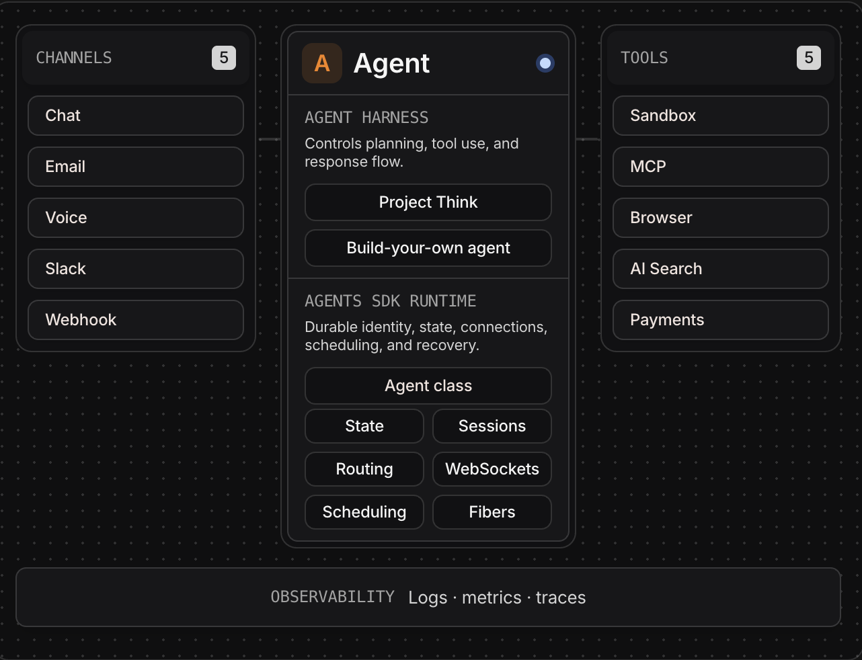
Server-side agent harness
- Server to agent harness
Client-side agent harness
- Browser to agent harness
AGENT HARNESS
┌─────────────────────────────────────────────────────┐
│ EXPERIENCE PLANE │
│ CLI · IDE · Web UI · Chat · API · Notifications │
├─────────────────────────────────────────────────────┤
│ INTENT / PLANNING PLANE │
│ Goal decomposition · Planning · Task DAG · Skills │
├─────────────────────────────────────────────────────┤
│ ORCHESTRATION PLANE │
│ Routing · Agents · Parallelism · HITL · Scheduling │
│ Retry · Pause · Resume · Rewind · Compensation │
├─────────────────────────────────────────────────────┤
│ CONTEXT PLANE │
│ Memory · RAG · Summaries · Rules · Repository Map │
│ Progressive disclosure · Context budgeting │
├─────────────────────────────────────────────────────┤
│ INFERENCE PLANE │
│ Model routing · Prompt contracts · Structured I/O │
│ Generation · Reasoning · Verification │
├─────────────────────────────────────────────────────┤
│ CAPABILITY PLANE │
│ Skills · Tools · MCP · LSP · Shell · Git · Browser │
│ APIs · Filesystem · Databases │
├─────────────────────────────────────────────────────┤
│ POLICY / SECURITY PLANE │
│ RBAC · Permissions · Secrets · Sandbox · Egress │
│ Approval gates · Policy engine · Resource limits │
├─────────────────────────────────────────────────────┤
│ STATE / DURABILITY PLANE │
│ Events · Checkpoints · Sessions · Artifacts │
│ Branches · Transactions · Replay │
├─────────────────────────────────────────────────────┤
│ TELEMETRY / GOVERNANCE PLANE │
│ Traces · Logs · Cost · Audit · Provenance · Evals │
└─────────────────────────────────────────────────────┘
Terminal User Interface (TUI)
Graphical User Interface (GUI / Editor)
Widgets, Browser Extensions, Native Desktop App(MacOS), iOS
Slack, Voice, Image, webhooks, MCP, A2A

Slide 14
In-Distribution vs. Out-of-Distribution
Agent System
│
┌─────────────┴─────────────┐
│ │
In-Distribution Out-of-Distribution
│ │
▼ ▼
Model Harness Custom Harness
│ │
Native reasoning Skills
Planning Tools
Coding Policies
Tool selection Integrations
General knowledge State machines
Common patterns Domain rules
│ │
└─────────────┬─────────────┘
▼
Runtime
This creates a useful design boundary:
Model Harness = leverage the model's existing intelligence. Custom Harness = provide the missing environment, constraints, knowledge, and deterministic behavior.
In-Distribution vs. Out-of-Distribution
Keep in-distribution capabilities close to the model; move out-of-distribution requirements into the harness.
In-Distribution (Model Harness): Capabilities the model already understands and performs reliably because they align with its training and native reasoning patterns. Keep these close to the model with minimal customization.
Examples: reasoning, planning, code generation, summarization, tool selection, natural-language interpretation, common development workflows, and standard model-native behaviors.
Out-of-Distribution (Custom Harness): Organization-, domain-, application-, or workflow-specific behavior that the model cannot be expected to know or execute consistently. Encode these requirements explicitly in the harness through deterministic tools, skills, policies, state machines, validation, and integrations.
Examples: enterprise policies, proprietary workflows, internal APIs, specialized tools, security boundaries, approval processes, domain-specific rules, custom state management, and organizational conventions.
The architectural principle becomes:
Don't customize the model for what it already knows. Customize the harness for what the model cannot reliably know.

Slide 15
Move Up the Abstraction Layer
Don't just build the system. Build the system that builds the system.
Instead of designing every agent, workflow, tool, policy, and integration individually, move one abstraction layer higher and create a meta-harness capable of constructing and configuring those systems.
Level 0 — Model
Intelligence
Level 1 — Agent
Model + Instructions + Tools
Level 2 — Harness
Agents + Skills + State + Policy + Orchestration
Level 3 — Meta-Harness
Builds and configures Harnesses
Level 4 — System Factory
Builds systems that build specialized systems
At the higher abstraction layer, the question changes from:
"How do we build this agent system?"
to:
"What primitives, contracts, and constraints allow the system to construct the right agent system for the problem?"
The resulting architecture becomes:
Intent / Objective
↓
System Architect
↓
Determine Requirements
↓
┌──────────────────────────────┐
│ Select / Generate │
│ │
│ • Models │
│ • Agents │
│ • Skills │
│ • Tools │
│ • Context │
│ • Workflows │
│ • State │
│ • Policies │
│ • Security boundaries │
│ • Verification │
└──────────────────────────────┘
↓
Generate Harness
↓
Validate Harness
↓
Deploy Runtime
↓
Observe + Evaluate
↓
Adapt / Regenerate
This creates a powerful separation:
Models provide intelligence. Harnesses provide controlled execution. Meta-harnesses compose the execution environment. System factories determine which harness should exist in the first place.
The ultimate abstraction is no longer agent orchestration.
It is system orchestration — dynamically constructing the appropriate combination of intelligence, capabilities, constraints, state, and execution architecture for a given objective.

Slide 16
The harness shouldn't make the LLM responsible for capabilities that software can enforce deterministically.
LLM responsibility
────────────────────
Understand intent
Reason
Plan
Choose capabilities
Diagnose failures
Generate alternatives
Make fuzzy judgments
Harness responsibility
────────────────────────
Permissions
State
Schemas
Retries
Timeouts
Budgets
Transactions
Isolation
Secrets
Logging
Audit
Validation
Execution
Recovery
What a harness usually owns
A harness usually owns:
Prompt construction — system prompts, memory, retrieved context, and per-turn instructions.
Model execution — the call to Workers AI, OpenAI, Anthropic, Gemini, or another provider.
Tool orchestration — server tools, client tools, MCP tools, approval flows, and continuation after tool results.
Message persistence — how user, assistant, and tool messages are saved and replayed.
Streaming and recovery — how responses stream to clients and resume after disconnects or Durable Object eviction.
Extension points — hooks before and after turns, steps, tool calls, and recovery events.

Slide 17
The harness shouldn't make the LLM responsible for capabilities that software can enforce deterministically.
USER INTENT
│
▼
Intent / Planner
│
Execution Graph
│
┌───────────┼───────────┐
▼ ▼ ▼
Agent Script Workflow
│ │ │
└───────────┼───────────┘
▼
Capability Router
│
Policy Evaluation
│
Permission / HITL Gate
│
Tool Contract
│
Sandbox / Environment
│
Execute
│
Validate
│
┌───────┴───────┐
│ │
Success Failure
│ │
Checkpoint Diagnose/Retry
│ │
└───────┬───────┘
▼
Event / Trace Store
│
Memory / State / Artifacts

Slide 18
This also explains why MCP, LSP, Docker, state.json, rules files, and ReAct aren't themselves the harness. They're mechanisms plugged into different planes.
The harness is the layer that determines what gets exposed, when it gets exposed, who can invoke it, under what policy, with what state, how execution is verified, and how the system recovers when something fails.
That is the difference between an agent that can use tools and an agent runtime capable of safely operating software autonomously.

Slide 19
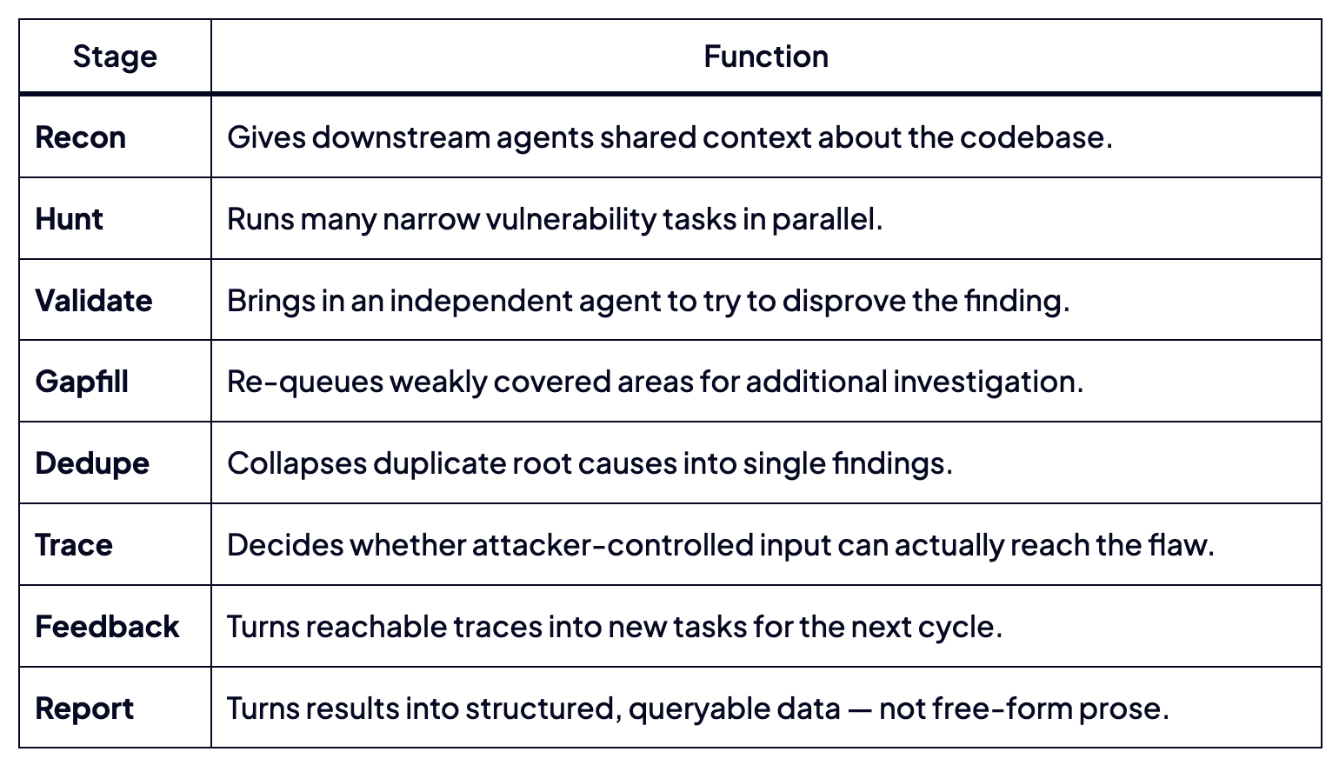
Lifecycle

Slide 20
The right Automation takes time
Private Eval + Benchmark
Continue learning loops
Observability
Fine-tune SLM
Build Custom Harness
Continuously improving Agents – test and learn
Version everything (artifacts, skills, agents)
Can you move up to an high abstruction layer
Can you build the system the builds the system

